Slide 1
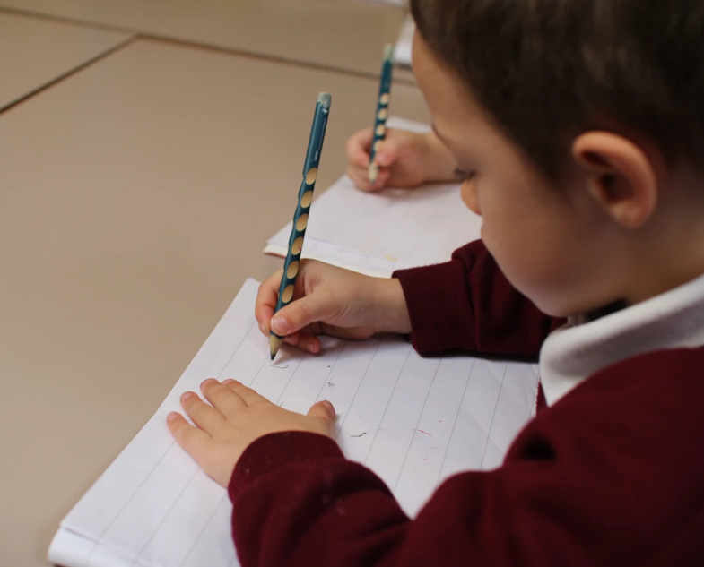
Handwriting
October 2023

Slide 2
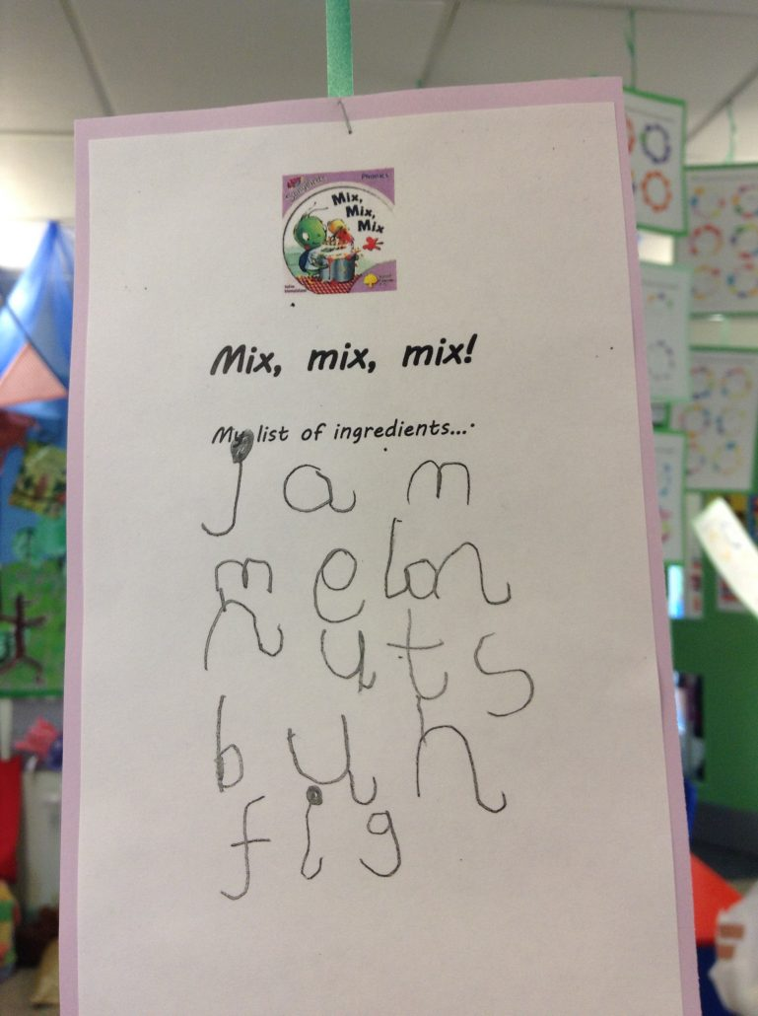
What is handwriting?
An efficient form of written communication.
The recording of thought, through language on paper/ other media – Language by hand.
A highly complex skill involving the integration of many factors.
A taught skills, which requires careful and consistent instruction with regular opportunities for practice.

Slide 3
Key Strengths needed for handwriting
Gross Motor Skills
Fine Motor Skills
Eye Tracking Ability
Spatial Awareness
Motor Memory
Visual Memory

Slide 4
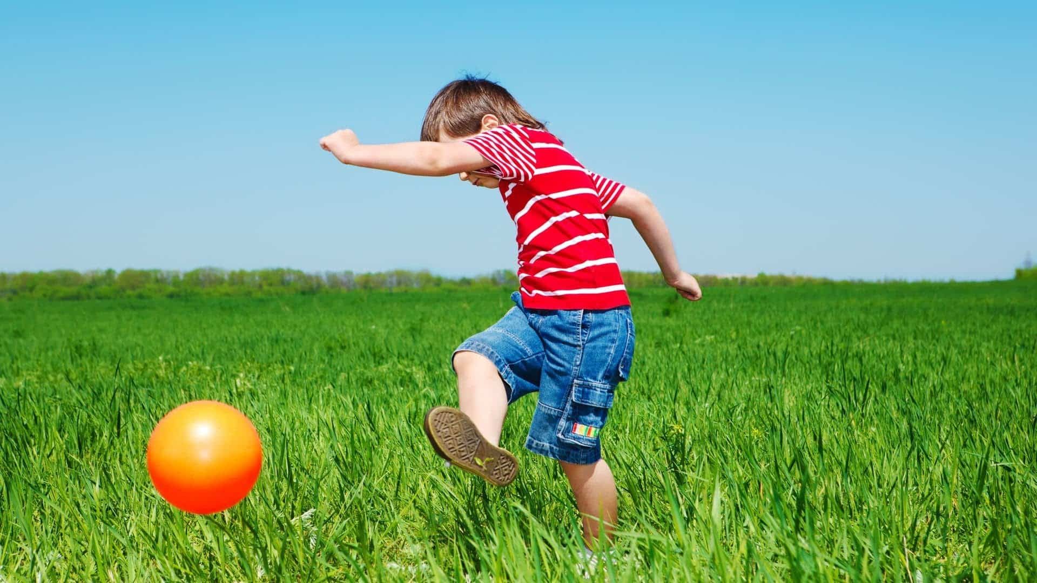
Gross Motor Skills
Playing on playground equipment
Climbing and crawling
Balancing – Twister
Jumping – trampoline
Dancing
Football
Swimming, gymnastics
Playdough
Gross motor skills will develop and strengthen the muscles in the body that are needed for handwriting.

Slide 5
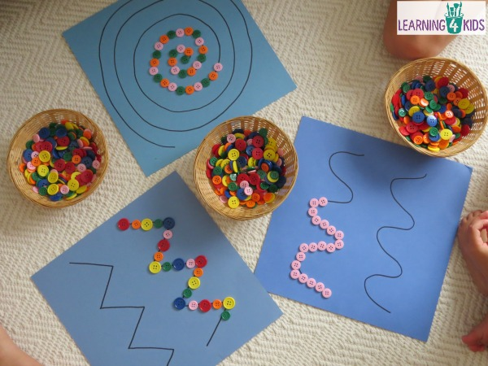
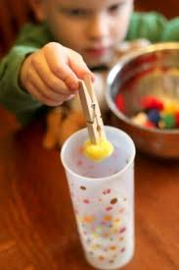
Fine Motor Skills
Fine motor skills will help strengthen your child’s hand muscles and help to develop an efficient tripod grasp.
Pegboards
Lacing and threading
Using tweezers to bring up small objects
Craft activities
Puzzles
Lego and other construction toys
Weaving
Finger painting
Dressing up using clothes with buttons, press-studs, zips and shoelaces
Playdough
Mixing ingredients
Cutting

Slide 6
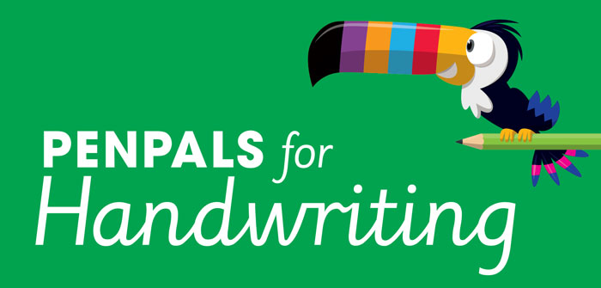
How we teach Handwriting at Hamstel
Gross and fine motor development in the Early Years.
PenPals
Daily handwriting lessons in Reception.
Teach letters in their letter families.

Slide 7
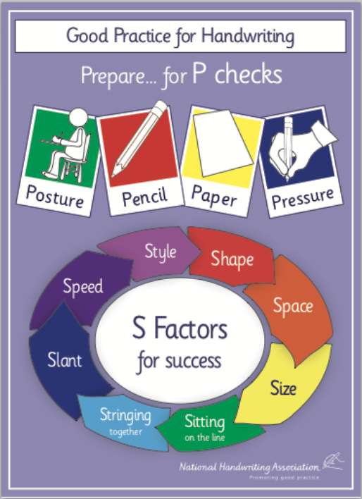
Effective handwriting practice has two dimensions
Preparation: The P checks
The Teaching Steps: The S Factors

Slide 8
Setting up to succeed – The P checks
The preparation we need to put in in order to go on our journey.
The P checks set us up to succeed in handwriting.

Slide 9
The Importance of Pencil Grip
Children need to develop a functional pencil grip.
It needs to be relaxed but allow efficient control of the pencil.
The pencil should be controlled by the fingers not the wrists.

Slide 10
Dynamic Tripod Grip
The importance of web space

Slide 11
Pencil – some tips
Pencils should be held about 2 cm from the tip.
Left handed writers may like to go a little higher.
A twisted loom band can help keep fingers from creeping down.
The same pencil or pen will not suit everyone.
Pencils and pens need to be looked after!
Handwriting should not hurt!

Slide 12
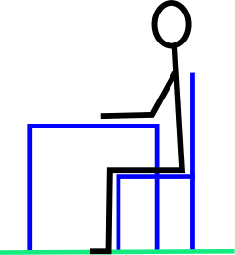
Posture for handwriting
Tables and chairs
Feet flat on the floor (or supported by a step)
Arms resting comfortably on the table.
Tummy – a fist’s distance from the table.
Other hand used to stabilise paper.
Head up straight.

Slide 13
Paper
Check that your other hand is holding the paper steady.
Gradually move the book upwards as the writing moves down the page.
Single sheets of paper need to be clipped to card.
If your writing is looking squashed, try using wider lines.

Slide 14
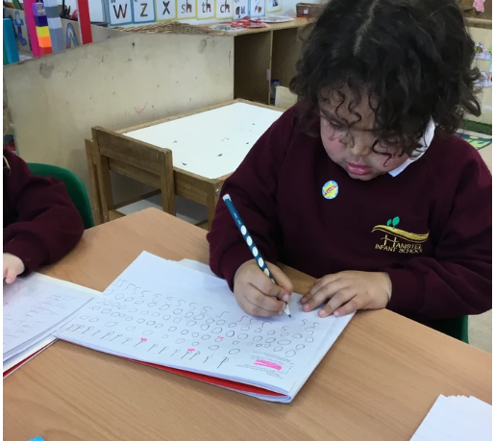
Pressure
Too much pressure on the pencil causes a tight grip which is very tiring.
Too little pressure makes your writing very pale and hard to read.
Practise using just the right amount of pressure.
Do warm ups before you start.
A different pencil can make a big difference.
Try a harder or softer lead.

Slide 15
Handwriting step by step – the s factors
In Years 5 and 6: Speed and Style
It is important that young children are taught to form each letter shape correctly before beginning to join.

Slide 16
How letterforms are learnt
The Logic
Teach letters in formation families – not in alphabetical order.
Adding an exit flick gives the letters a forward movement and the potential to join.
When the child is ready, they can be shown how to join letters.
The Practise
Correct letter formation must be modelled at all times.
Letter formation should be practised in a variety of ways
Paper and pencil practice is the final stage of learning and after the child can air write the letter shapes with eyes closed.

Slide 17
Letters belong in families
Letters can be put into groups according to the movement needed to make them.
When children learn to write a new letter, the lead letter of its team will help them start.

Slide 18
The four letter families

Slide 19
The four letter families

Slide 20
Two important starting points!
Always start at 1 on the clock. Stroke the caterpillar from its head to its tail.
Activate the robot down his body, back up and over his arm.

Slide 21
Some letters have exit flicks
Letters which end on the base line have a rounded exit flick.
This helps with spacing and joining.
a d h l i m n u

Slide 22
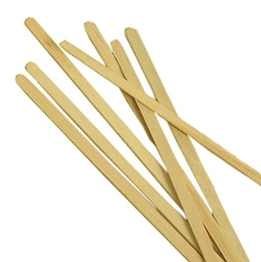
The spaces should be even and match the size of the writing.
They should be about the same size as an o or oo.
You need to gradually visualise a good sized space.
Until then – a lolly stick or coffee stirrer can help.
Using ‘Finger Spaces’ isn’t helpful in the long run – fingers grow bigger and writing gets smaller!

Slide 23
Writing sits on the baseline
Sitting on the baseline helps with legibility.
Once children are secure in forming letters correctly, they need to know where to position them in relation to the base line.

Slide 24
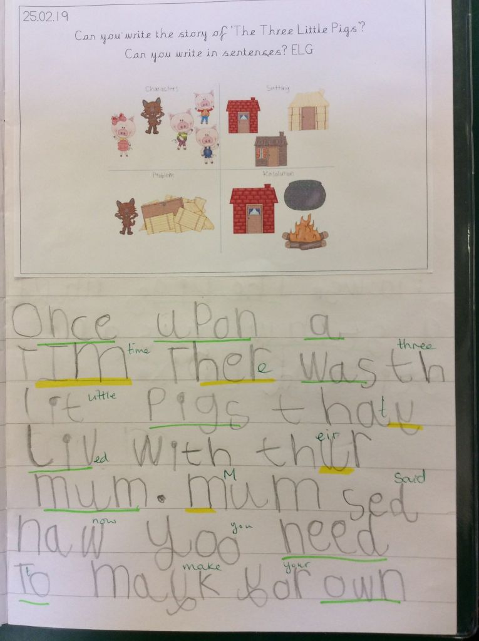
EYFS curriculum
Writing – ELG Expected
Children at the expected level of development will:
Write recognisable letters, most of which are correctly formed;
Spell words by identifying sounds in them and representing the sounds with a letter or letters;
Write simple phrases and sentences that can be read by and to others
Fine Motor Skills– ELG Expected
Children at the expected level of development will:
Hold a pencil effectively in preparation for fluent writing – using the tripod grip in almost all cases;
Use a range of small tools, including scissors, paint brushes and cutlery;
Begin to show accuracy and care when drawing.

Slide 25
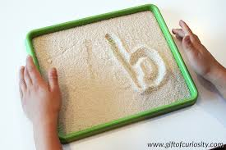
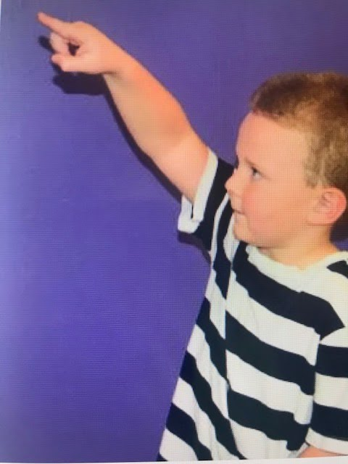
How to help at home
Gross Motor Activities
Go to the park
Play ball games
Go swimming
Fine Motor Activities
Getting dressed
Lego
Puzzles
Playdough
Threading
Handwriting Practice
Make it fun
Practise in the air first
Practise letters in their letter families
Show you child how to form the letter correctly. Talk about what you are doing. Use a light coloured pen or pencil so your child can trace over.
Be positive but correct some mistakes. We don’t want these to become habits!

